Slide 1

Phylogenetic Trees

Slide 2
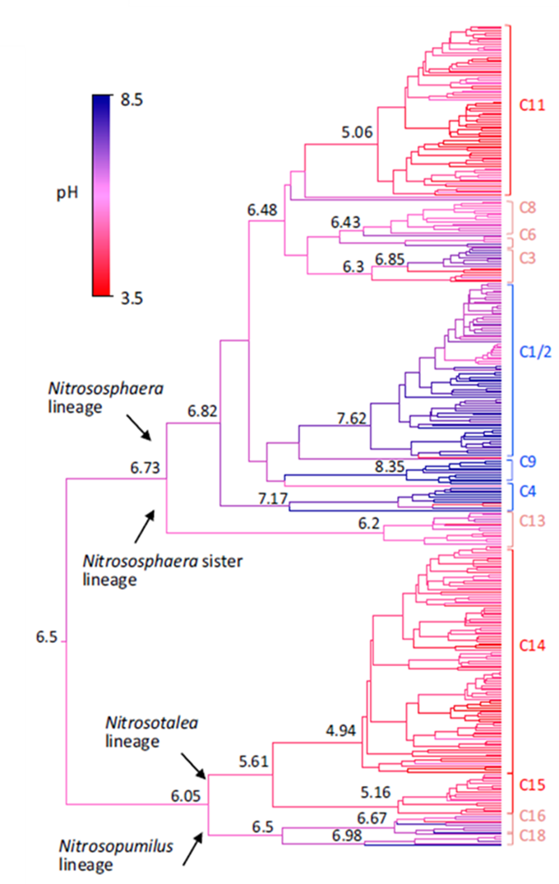
Coupling of diversification and pH adaptation during the evolution of terrestrial Thaumarchaeota
Ancestral pH preferences are shown for the 370-sequence amoA tree based on a ridge regression approach (28), with estimates of ancestral pH provided at key nodes.
Gubry-Rangin et al. 2015

Slide 3
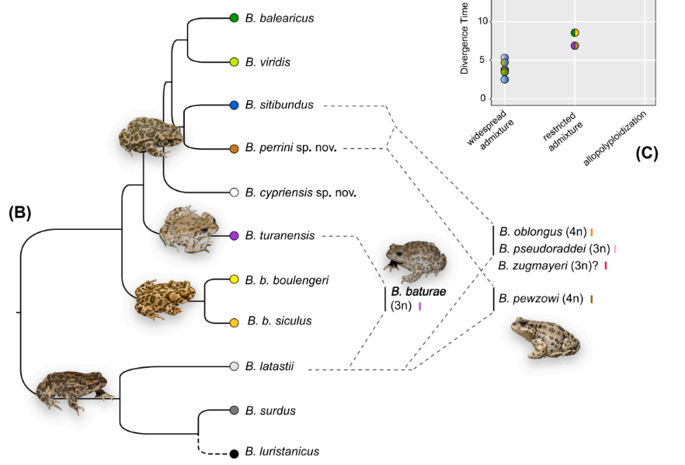
Fifteen shades of green: The evolution of Bufotes toads revisited
Species tree of all diploid taxa and the hybridization events that led to known allopolyploids.
Dufresnes et al. 2019

Slide 4
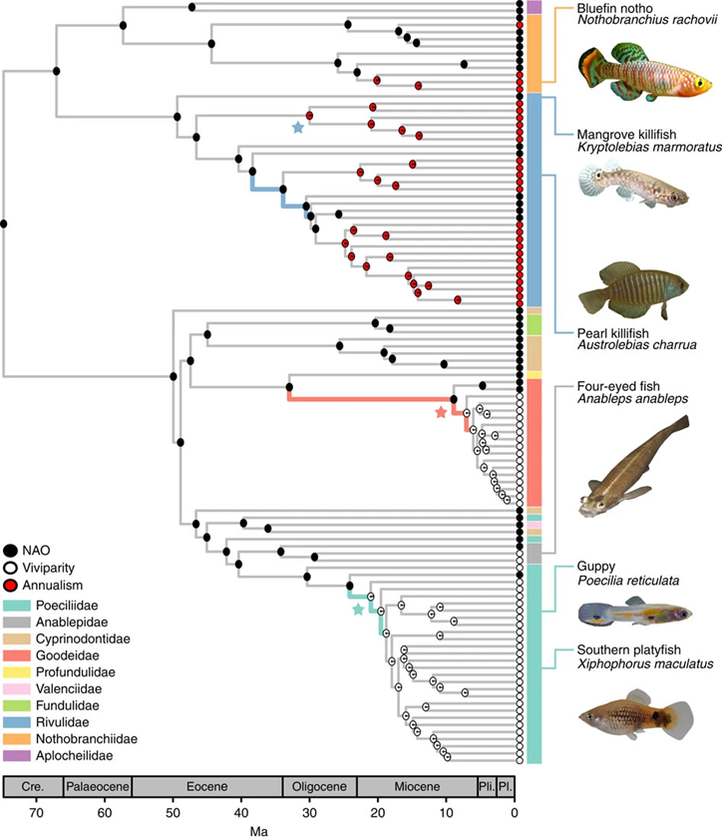
Viviparity stimulates diversification in an order of fish
Phylogenetic tree of Cyprinodontiformes.
A Bayesian maximum clade credibility tree is shown with ancestral reconstructed states of viviparity andannualism.
Pie charts in each node represent MuSSE reconstructed ancestral states.
Helmstetter et al. 2016

Slide 5
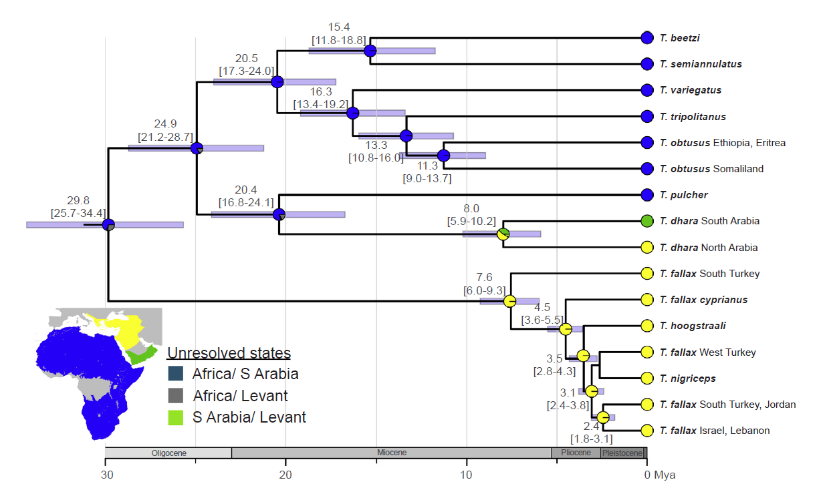
Ancient diversification, biogeography, and the role of climatic niche evolution in the Old World cat snakes (Colubridae, Telescopus)
Time-calibrated tree resulting from Bayesian analysis.
Biogeographical origin of each lineage is marked at the tree tip with a colour corresponding to the map in the lower left corner.
Pie charts at the nodes show the probability of each ancestral area.
Šmíd et al. 2019
Notes:
Time-calibrated tree resulting from Bayesian analysis. And results of the biogeographic reconstruction. Mean age estimates are given
by nodes together with their 95% HPD intervals (also indicated by blue bars). The biogeographical origin of each lineage is marked at the tree tip with a color
corresponding to the map in the lower left corner. Pie charts at the nodes show the probability of each ancestral area.

Slide 6

Phylogenetic Trees in R

Slide 7
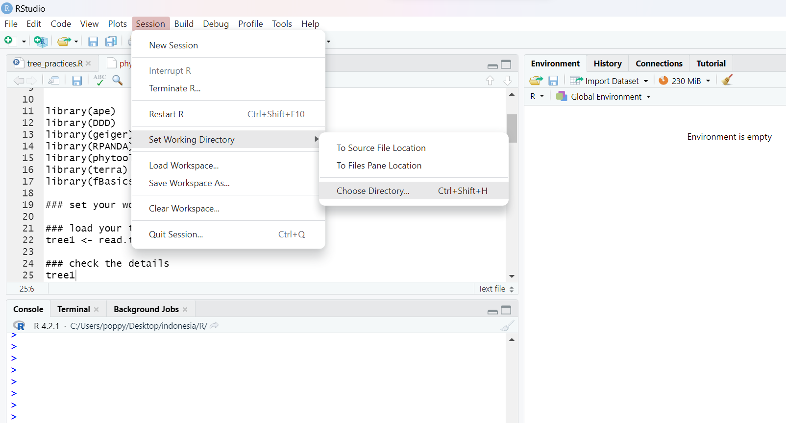
Open R, set working directory, open R script
setwd("C:/Users/poppy/Desktop/indonesia/R")

Slide 8
### load your tree
tree1 <- read.tree("cetacea.tre")
### check the details
tree1
### plot your tree
plotTree(tree1,offset=1)
### make the labels fit better
plotTree(tree1,ftype="i",fsize=0.4,lwd=1)

Slide 9
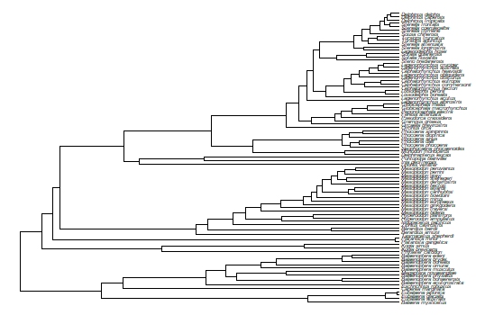
Plot some phylogenetic trees

Slide 10
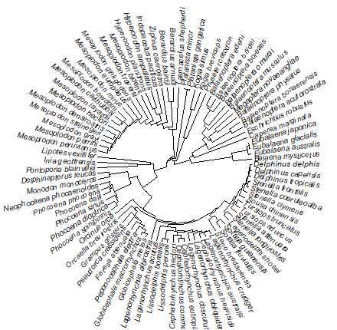
Same tree as a fan
plotTree(tree1,type="fan",
fsize=0.6,lwd=1, ftype="i")

Slide 11
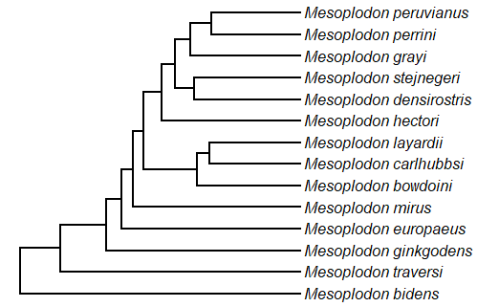
Looking at one clade

Slide 12
Adding Images to Trees

Slide 13
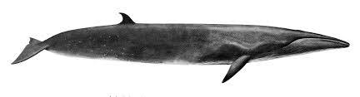
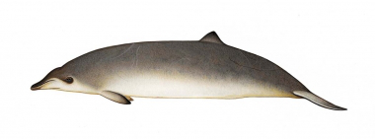
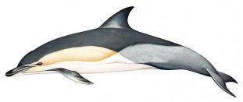
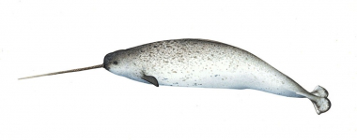

Slide 14
You don’t have to complicate things
You can make your phylogenetic tree in R
Use PowerPoint to add images to your tree
- (if you have Photoshop this can be better for high quality figures)
It is simpler and easier to modify figures, and more flexible
Save as a PDF, JPG or PNG images

Slide 15
Exercise
Choose the cetacean tree, humming bird tree, a clade from one of these trees, or one of your own trees
Save the tree as an image
Use PowerPoint (or Photoshop) to make a figure with your phylogenetic tree and images of some species
Save as PDF, JPG, or PNG

Slide 16
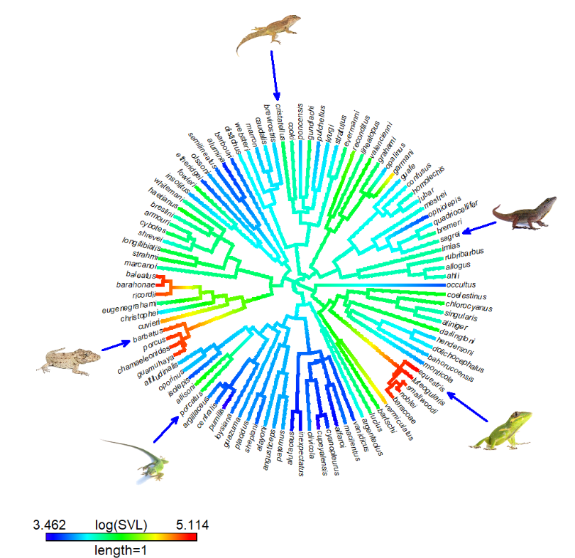
It is possible to add images in R
Anolis example from phytools
http://phytools.org/mexico2018/ex/12/Plotting-methods.html

Slide 17
Trees and Trait Data
The code for the following trees have been adapted from Liam J. Revell

Slide 18
Discreet Trait States

Slide 19
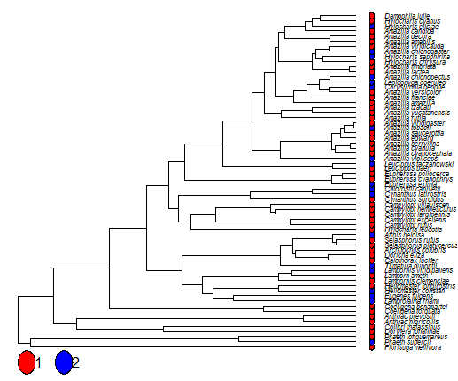
Hummingbird phylogenetic tree
2 discreet trait states: red or blue
Character distribution at tips

Slide 20
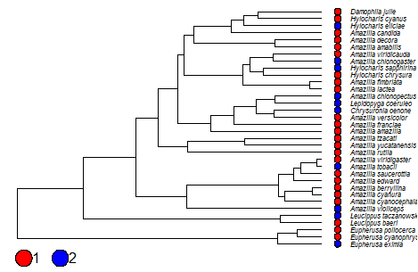
Clade from the Hummingbird phylogenetic tree
2 discreet trait states: red or blue
Character distribution at tips

Slide 21
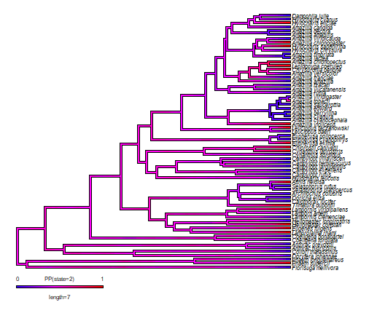
Hummingbird phylogenetic tree
2 discreet trait states: red or blue
Posterior density from stochastic mapping at the edges & nodes of the tree

Slide 22
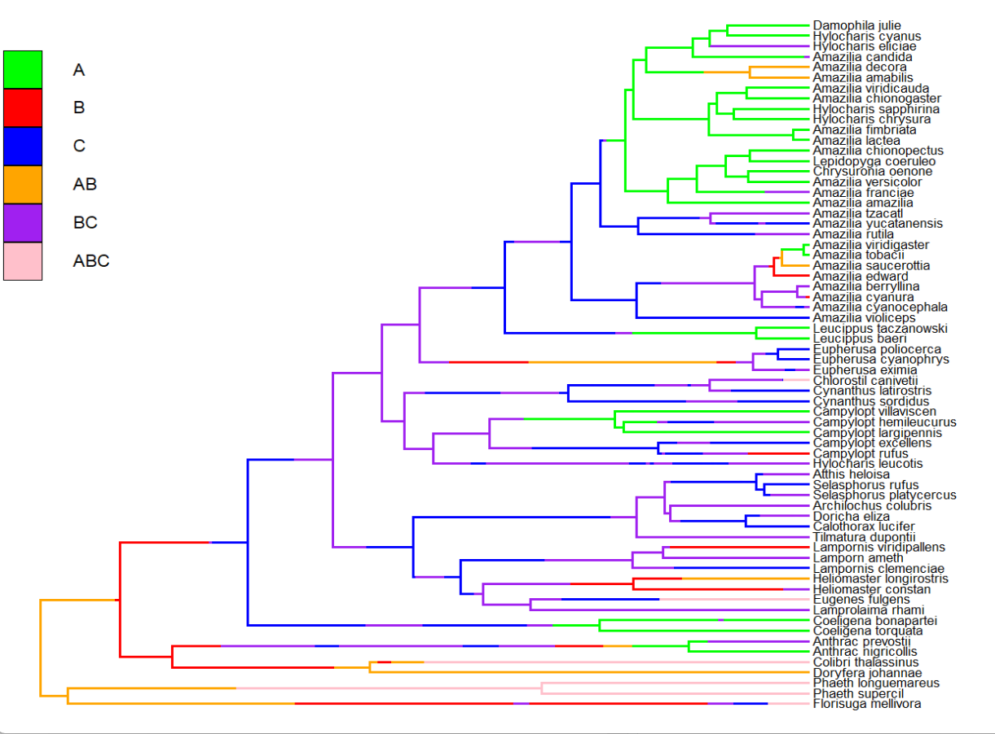
Hummingbird phylogenetic tree
6 discreet trait states: regions
Stochastic character mapping

Slide 23
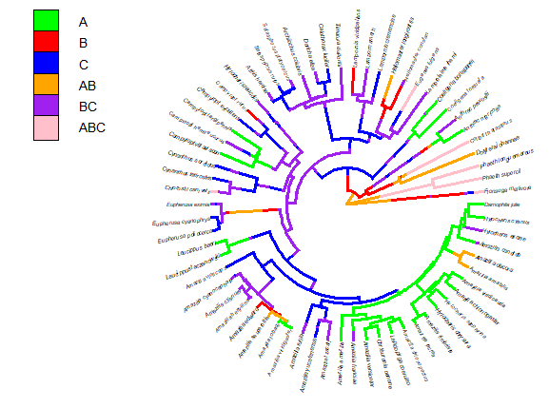
Hummingbird phylogenetic tree
6 discreet trait states: regions
Stochastic character mapping

Slide 24
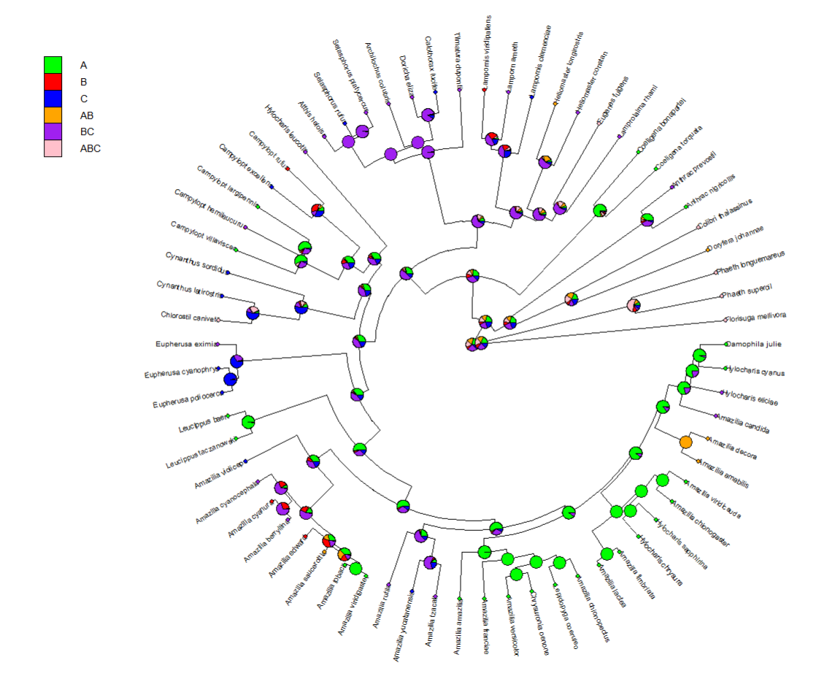
Hummingbird phylogenetic tree
6 discreet trait states: regions
Stochastic character mapping with posterior probabilities for node states

Slide 25
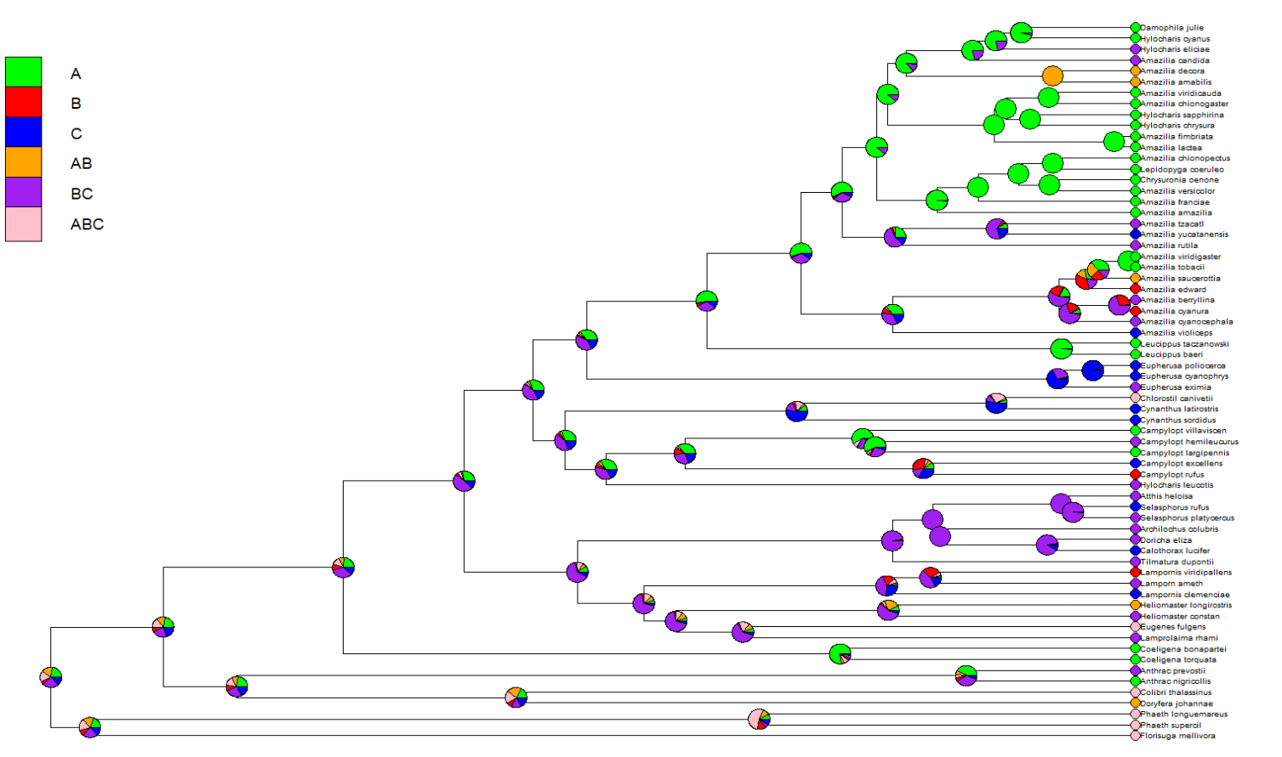
Hummingbird phylogenetic tree
6 discreet trait states: regions
Stochastic character mapping with posterior probabilities for node states

Slide 26
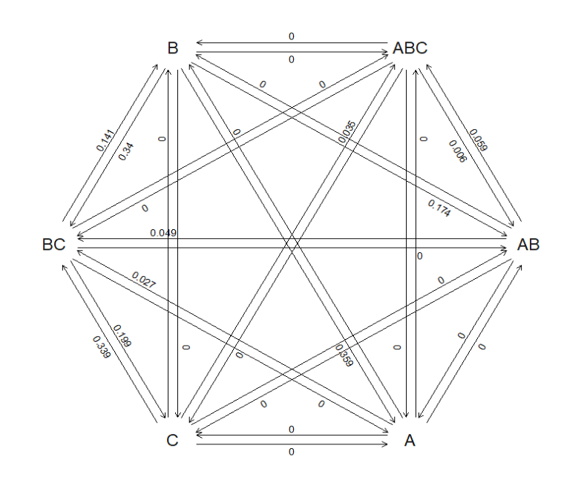
The fitted discrete character model for Hummingbird eco-regions
showing transition rates between states (regions)
0 = transition not possible

Slide 27
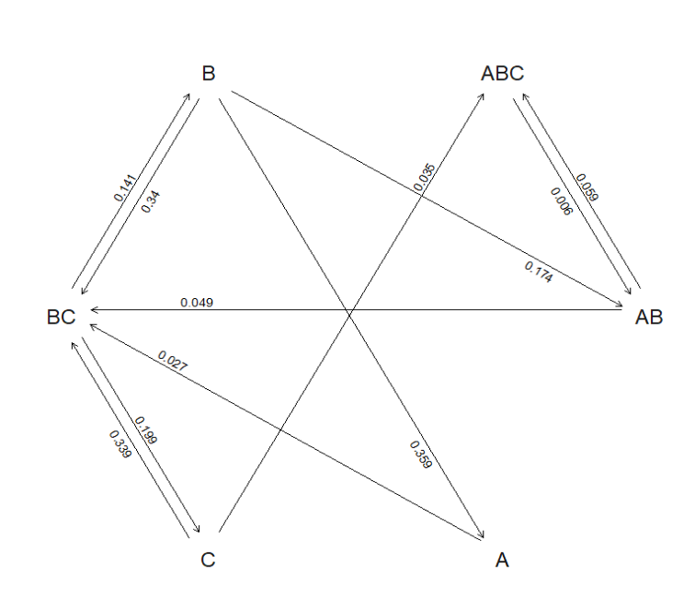
The fitted discrete character model for Hummingbird eco-regions showing transition rates between states (regions)

Slide 28
Continuous Trait States

Slide 29
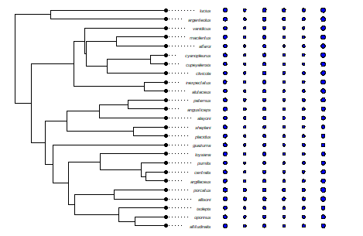

Slide 30
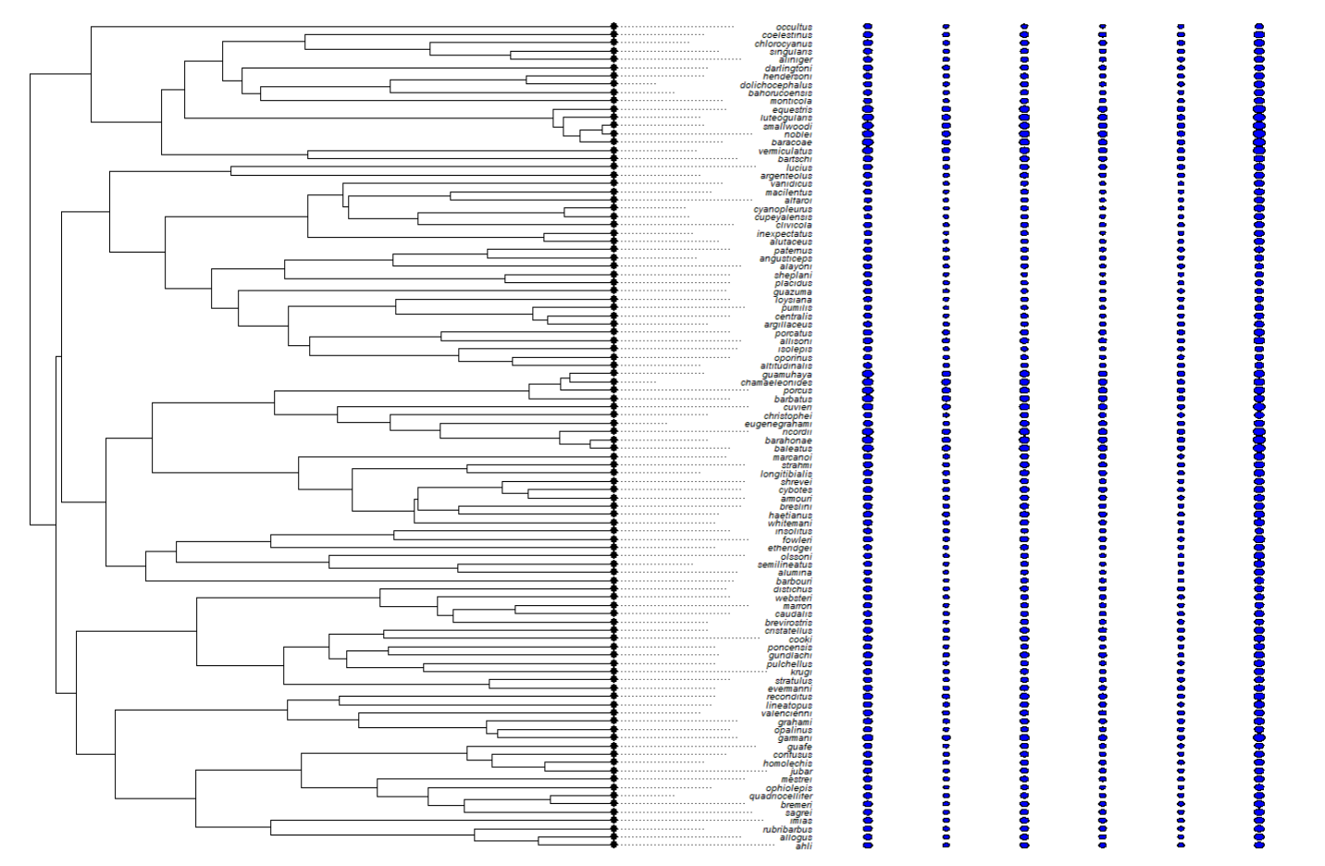

Slide 31
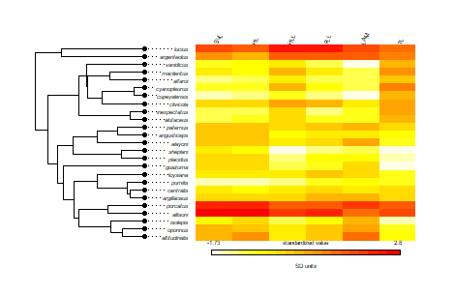

Slide 32
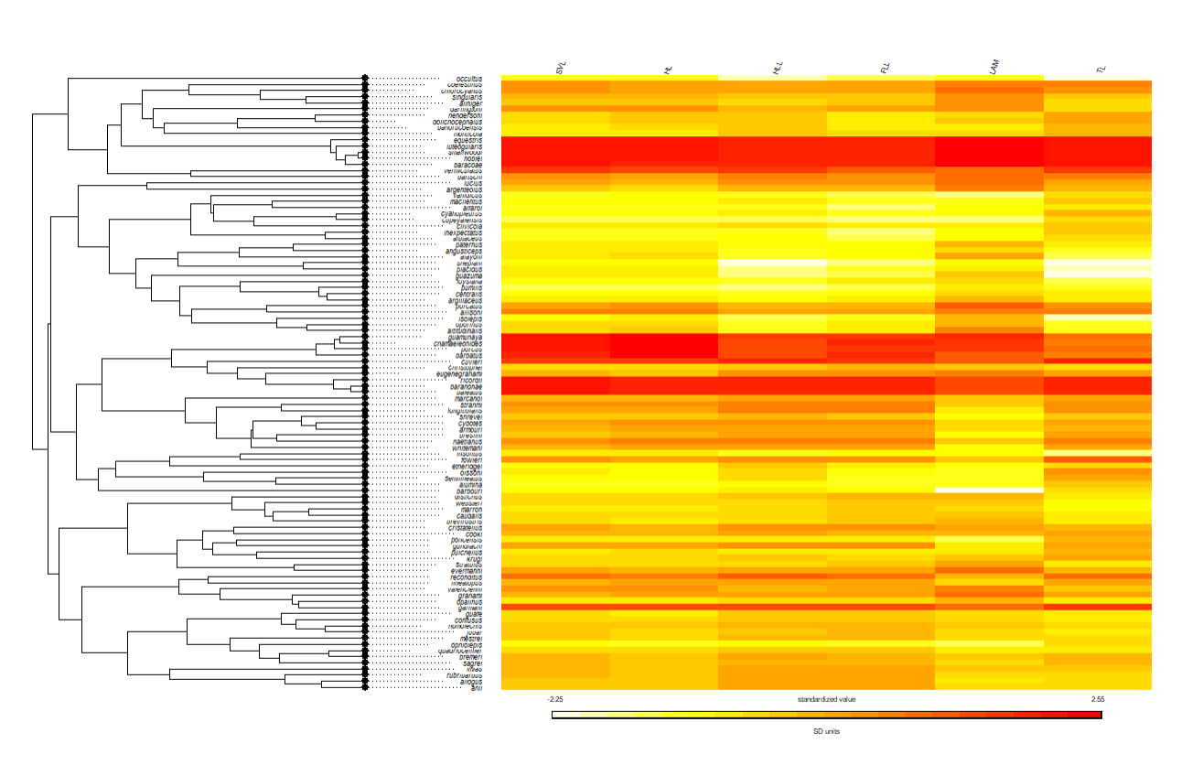

Slide 33
